Slide 1
ACP and PGA
Two Algebraic Theories
in Computer Science
André van Delft
LambdaDays Krakow, 18 February 2016

Slide 2
Overview
ACP - Algebra of Communicating Processes
Axioms
SubScript: GUI Application
PGA - Program Algebra
Axioms
Java static variable initialization puzzler
Conclusion

Slide 3
Algebra of Communicating Processes - 1
Bergstra & Klop, Amsterdam, 1982 - ...
ACP ~ Boolean Algebra
+ choice
· sequence
0 deadlock
1 empty process
atomic actions a,b,…
parallelism
communication
disruption, interruption time, space, probabilities
money
...

Slide 4
Algebra of Communicating Processes - 2
x+y = y+x (x+y)+z = x+(y+z) x+x = x (x+y)·z = x·z+y·z (x·y)·z = x·(y·z)
0+x = x 0·x = 0 1·x = x x·1 = x
(x+1)·y
= x·y + 1·y
= x·y + y

Slide 5
Algebra of Communicating Processes - 3
x║y = x╙y + y╙x + x|y
(x+y)╙z = ... a·x╙y = ... 1╙x = ... 0╙x = ... (x+y)|z = ... ... = ...
Notes:
Process terms are rewritable to 4 simple forms.
This eases axiomatic definition of new operators
Parallelism is a choice: left first and then the rest in parallel, or right first and then the rest in parallel, or communicatieirst and then the rest

Slide 6
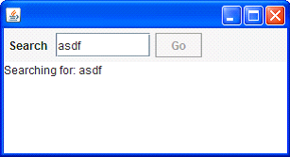
SubScript: GUI application - 1
Input Field
Search Button
Searching for…
Results
Notes:
Example: a typical search application. Simple on the outside, but still hard to program.
On clicking the search button, a message “Searching for: …” appears in the text area, and the button is disabled.
Meanwhile a background task starts to search on the Internet or in a database. This may last some time.
When the background task is ready the results should be displayed, and the buttun should be enabled again. This must happen in the GUI thread.

Slide 7
GUI application - 3
live = clicked(searchButton)
@gui: {outputTA.text="Starting search.."}
{* Thread.sleep(3000) *}
@gui: {outputTA.text="Search ready"}
...
Sequence operator: white space and ;
gui: code executor for
SwingUtilities.InvokeLater+InvokeAndWait
{* ... *}: by executor for new Thread
Enable/disable button: for free
searchButton
Notes:
Solution in SubScript.
None of the lines are executed in normal mode:
“clicked” is a user action
@gui: indicates execution in GUI thread
“{* …* *} indicates execution in new thread
“…” is “etcetera”; “while(true)” would do the same
Definitions using “=“, just like in algebra, and in Scala

Slide 8
SubScript: GUI application - 2
val searchButton = new Button("Go”) {
reactions.+= {
case ButtonClicked(b) =>
enabled = false
outputTA.text = "Starting search...”
new Thread(new Runnable {
def run() {
Thread.sleep(3000)
SwingUtilities.invokeLater(new Runnable{
def run() {outputTA.text="Search ready”
enabled = true
}})
}}).start
}
}
Notes:
A typical solution in Scala; in Java it would be similar.
Much indentation and many braces.
Hard program code.
The text suggests top-down order, but there is some flow in the opposite direction.
Costly, boring and error-prone.

Slide 9
SubScript: GUI application - 3
live = searchSequence...
searchSequence = searchCommand
showSearchingText
searchInDatabase
showSearchResults
searchCommand = searchButton
showSearchingText = @gui: {:outputTA.text = "…":}
showSearchResults = @gui: {:outputTA.text = "…":}
searchInDatabase = {* Thread.sleep(3000) *}
Notes:
Solution in SubScript with more refinements.

Slide 10
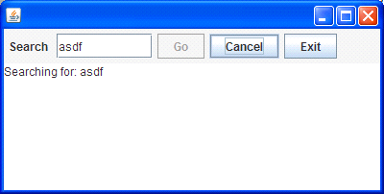
SubScript: GUI application - 4
Search: button or Enter key
Cancel: button or Escape key
Exit: button or ; ; “Are you sure?”…
Search only allowed when input field not empty
Progress indication
Notes:
Extra requirements to make the application more user friendly

Slide 11
SubScript: GUI application - 5
live = searchSequence...
|| exit
searchCommand = searchButton
+ Key.Enter
cancelCommand = cancelButton + Key.Escape
exitCommand = exitButton + windowClosing
exit = exitCommand @gui: confirmExit ~~(b:Boolean)~~> while(!b)
cancelSearch = cancelCommand @gui: showCanceledText
searchSequence = searchGuard searchCommand
showSearchingText searchInDatabase showSearchResults
/ cancelSearch
searchGuard = if(!searchTF.text.isEmpty) . anyEvent(searchTF) ...
searchInDatabase = {*Thread.sleep(3000)*} || progressMonitor
progressMonitor = {*Thread.sleep( 250)*}
@gui:{searchTF.text+=here.pass} ...
Notes:
live– 2 parallel process, with “or” logic: ready when exit is ready.
Exit awaits command; then asks “Are you sure”. Stops after “Yes”, else iterates
Command: button or key or close box
searchGuard: guards searchCommand – only active when text field is non empty
white space – sequence, strong binding
; - sequence, weak binding
/ - right hand side may disrupt left hand side
progressMonitor: wait ¼ sec; write counter to text area; iterated. Or-parallel

Slide 12
PGA - Program Algebra
/ Instruction Sequences 1
Computational Model
Alternative for Turing Machine
Close to Assembly Language: jumps
Sequential composition
Axioms
Higher levels: PGLA, PGLB, ...
Defined using simple projections
Applied to
method call dispatch in Ruby
static variable initialization in Java

Slide 13
PGA - Program Algebra
/ Instruction Sequences 2
Primitive instructions: for each a ∈ A, k ∈ N
a - basic instruction; execution yields true/false
+a - positive test instruction a true: execute next instruction
a false: skip next instruction
-a - negative test instruction
! - termination instruction
#k - relative jump instruction
Programs X, Y, ...
Primitive instruction
X; Y
X^{ω} (= X; X; X; ...)
From Ponse & Van der Zwaag, Introduction to Program and Thread Algebra

Slide 14
PGA - Program Algebra
/ Instruction Sequences 3
Axioms for instruction sequence congruence:
(X; Y ); Z = X; (Y ; Z) (PGA1)
(X^{n})^{ω} = X^{ω} (PGA2, n ≥ 1, X¹ = X, X^{n+1} = X; X^{n})
X^{ω}; Y = X^{ω} (PGA3)
(X; Y )^{ω} = X; (Y ; X)^{ω} (PGA4)
A proof of unfolding (i.e., Xω = X; Xω):
X^{ω} = (X; X)^{ω} (PGA2, n = 2)
= X; (X; X)^{ω} (PGA4)
= X; X^{ω} (PGA2)
From Ponse & Van der Zwaag, Introduction to Program and Thread Algebra

Slide 15
PGA - Program Algebra
/ Instruction Sequences 4
PGA
PGLA \\#n repeat last n instructions
PGLB backward jump
PGLC conventional termination, without !
PGLD absolute jump
PGLDg numeric labels, jump-to instruction
PGLE Instruction refinement preparation
PGLEc If-then-else
PGLEcw While
PROJECTION
EMBEDD I NG

Slide 16
PGA - Program Algebra
/ Instruction Sequences 5
What is a program?
Answer (Bergstra, ±1998):
A program is defined relative to a programming language
A programming language is a pair (L, φ) with L a set of expressions and φ a projection to PGA
From Ponse & Van der Zwaag, Introduction to Program and Thread Algebra

Slide 17
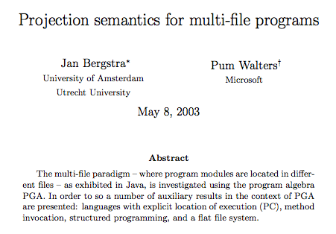
PGA - Program Algebra
/ Instruction Sequences 6

Slide 18
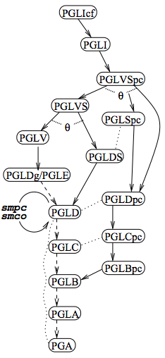
PGA - Program Algebra
/ Instruction Sequences 7

Slide 19
PGA - Program Algebra
/ Instruction Sequences 8
File | c0.java | c1.java | c2.java
Java Code | class c0 { static void main (String s[]) { c1.m7(); } } | class c1 { static boolean b3 = c2.b5; static boolean b6 = true; static void m7() { if (b3) { b3 = false; c2.b5 = false; m7(); } else { c2.m8(); } } } | class c2 { static boolean b4 = c1.b6; static boolean b5 = true; static void m8() { System.out.println(b4); System.out.println(b5); System.out.println(c1.b6); } }

Slide 20
PGA - Program Algebra
/ Instruction Sequences 9
File | c0.java | c1.java | c2.java
PGLIcf Code | R##c2[1]; R##c1[1]; R##c1[7]; ! | [1] -smbv:5; ##[2]; smbv:3.set:true; [2]; smbv:6.set:true; ##R; [7]; -smbv:3; ##[3]; smbv:3.set:false; smbv:5.set:false; R##[7]; ##[9]; [3]; R##c2[8]; [9]; ##R | [1] -smbv:6; ##[2]; smbv:4.set:true; [2]; smbv:5.set:true; ##R; [8]; *skip; ##R

Slide 21
PGA - Program Algebra
/ Instruction Sequences 10
PGLI
R##[2,1]; R##[1,1]; R##[1,7]; !; !; !; [2,1]; -smbv:6; ##[2,2]; smbv:4.set:true; [2,2]; smbv:5.set:true; ##R; | [2,8]; *skip; ##R; !; !; [1,1]; -smbv:5; ##[1,2]; smbv:3.set:true; [1,2]; smbv:6.set:true; ##R; [1,7]; | -smbv:3; ##[1,3]; smbv:3.set:false; smbv:5.set:false; R##[1,7]; ##[1,9]; [1,3]; R##[2,8]; [1,9]; ##R; !; !

Slide 22
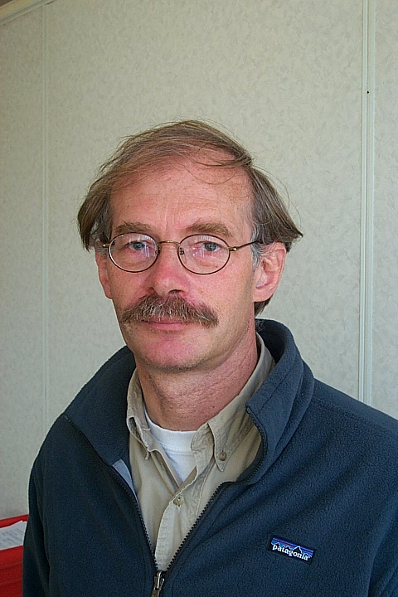
Jan Bergstra
1951; Mathematician
1976-1982 Leiden University: Logic, λ
1982-2016 University of Amsterdam:
1982: ACP, with Jan Willem Klop
1997: Java semantics
1998: PGA, with Marijke Loots e.a.
2004: Promise Theory, with Mark Burgess
2005: Thread Algebra
2010: Proposition Algebra
2013: Head Informatics Section Academia Europaea
2016: Retiring

Slide 23
Conclusion
ACP
Very Applicable to Programming: SubScript
Low Acceptance
Lower than CSP, CCS
PGA
Potential Successor of Turing Machine
Barely Known
Opportunities

Slide 24
References
SubScript
Main site: subscript-lang.org
Repository: github.com/scala-subscript
Jan Bergstra
Personal page: staff.fnwi.uva.nl/j.a.bergstra
PGA
Main site: www.science.uva.nl/research/prog/projects/pga/
Program algebra for sequential code: staff.fnwi.uva.nl/a.ponse/DPM/JLAP51-125-156.pdf
Projection semantics for multi-file programs: www.science.uva.nl/research/prog/projects/pga/pub/MF.pdf
A Projection of the Object Oriented Constructs of Ruby to Program Algebra: ivi.fnwi.uva.nl/tcs/pub/mastertheses/RMGeerlings.ps.gz
An Introduction to Program and Thread Algebra www.cs.swan.ac.uk/cie06/files/d133/c06.pdf
A SWOT analysis of Instruction Sequence Theory http://vixra.org/pdf/1502.0231v1.pdf

Slide 25
Algebra of Communicating Processes - 2
Less known than CSP, CCS
Specification & Verification
Communication Protocols
Production Plants
Railways
Coins and Coffee Machines
Money and Economy
Strengths
Familiar syntax
Precise semantics
Reasoning by term rewriting
Events as actions

Slide 26
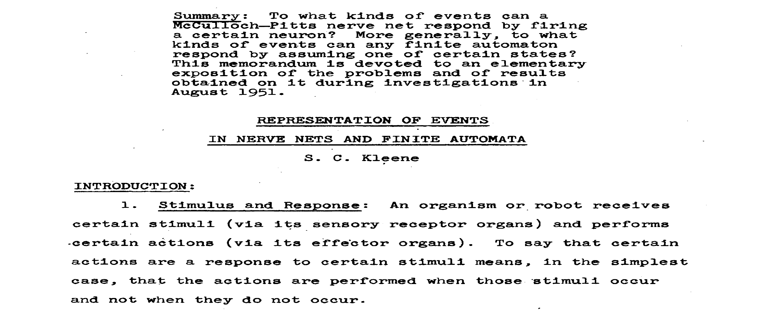
Kleene, 1951 - 1

Slide 27
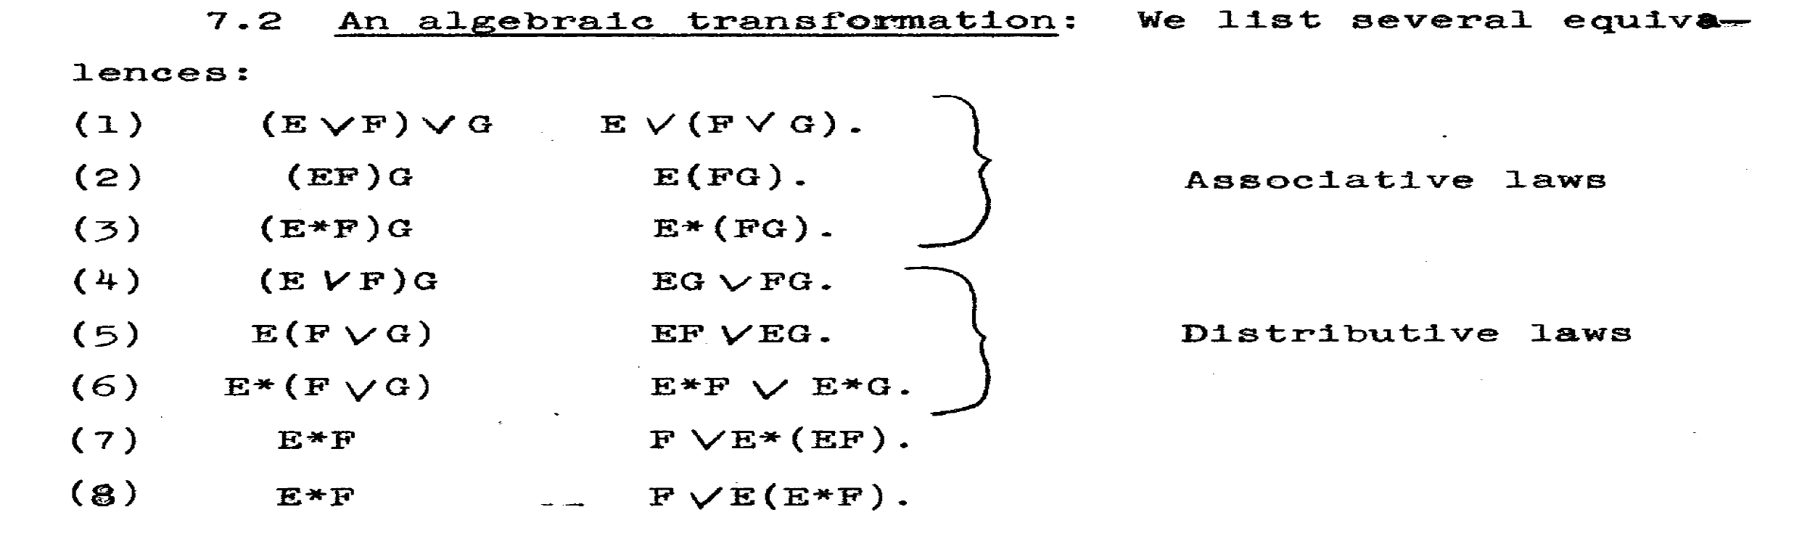
Kleene, 1951 - 2

Slide 28
Some History
1955 Stephen Kleene ~~> regular expressions, *
Noam Chomsky ~~> language grammars
1960 John Backus & Peter Naur ~~> BNF
Tony Brooker ~~> Compiler Compiler
1971 Hans Bekič ~~> Algebra of Processes
1973 Stephen Johnson ~~> YACC
1974 Nico Habermann & Roy Campbell ~~> Path Expressions
1978 Tony Hoare ~~> Communicating Sequential Processes (CSP)
1980 Robin Milner ~~> Calculus of Communicating Systems (CCS)
1982 Jan Bergstra & Jan Willem Klop ~~> Algebra of Communicating Processes (ACP)
1989 Robin Milner ~~> Pi-Calculus
Henk Goeman ~~> Self-applicative Processes

Slide 29
ACP Language Extensions
1980: Jan van den Bos - Input Tool Model [Pascal, Modula-2]
1988-2011: André van Delft - Scriptic [Pascal, Modula-2, C, C++, Java]
1994: Jan Bergstra & Paul Klint - Toolbus
2011-...: André van Delft - SubScript [Scala, JavaScript (?)]
Application Areas:
GUI Controllers
Text Parsers
Discrete Event Simulation
Reactive, Actors, Dataflow

Slide 30


Programming Paradigms
Smalltalk
Scala
Java 8
Parboiled
SubScript
Lisp
Haskell
λ
Prolog
YACC
sh
JavaCC
Declarative
Imperative
C++
Java 1..7
Objects
Assembly, C

Slide 31
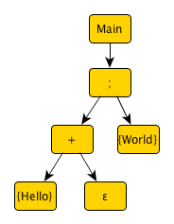
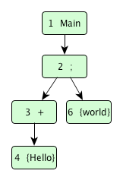
Implementation - 1
Branch of Scalac: 1300 lines (scanner + parser + typer)
script Main = ({Hello} + ε); {World}
import subscript.DSL._ def Main = _script('Main) { _seq(_alt(_normal{here=>Hello}, _empty), _normal{here=>World} ) }
Virtual Machine: 2000 lines
static script trees
dynamic Call Graph
Swing event handling scripts: 260 lines
Graphical Debugger: 550 lines (10 in SubScript)

Slide 32
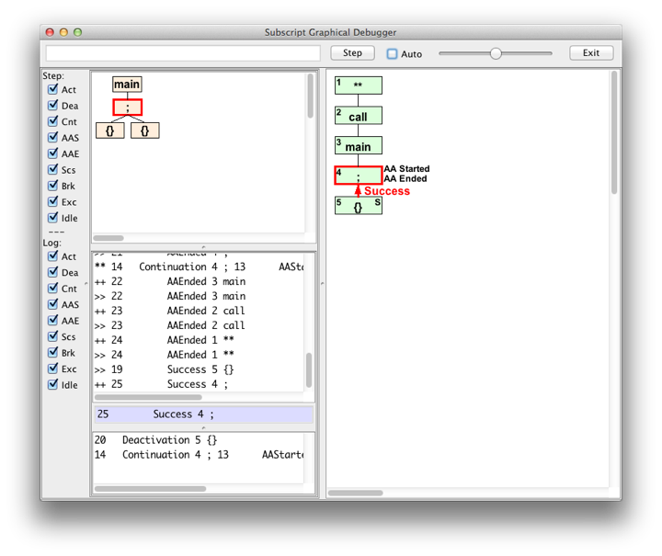
Debugger - 1

Slide 33
Example: Slick 3
Reactive Streams for Asynchronous Database Access in Scala
http://www.infoq.com/news/2015/05/slick3
val q = for (c<-coffees) yield c.name
val a = q.result
val f: Future[Seq[String]] = db.run(a)
f.onSuccess { case s => println(s"Result: $s") }
val q = for (c<-coffees) yield c.name
q ~~(s)~~> println(s"Result: $s")

